Slide 1

Azure Machine Learning Studio: Four Tips from the Pros
October 20th, 2018
Brad Llewellyn
Senior Analytics Associate – Data Science
Syntelli Solutions

Slide 2

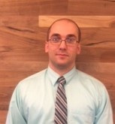



MCSE: Data Management and Analytics
MCSE: Cloud Platform and Infrastructure
MCSA: SQL Server 2012/2014
MCSA: Cloud Platform
MCSA: Machine Learning
MCSA: SQL 2016 BI Development
M.S. Statistics: University of South Carolina
Analytics Consultant – 6 Years
Syntelli Solutions – <1 Year
@BreakingBI
https://www.linkedin.com/in/bradllewellyn
http://breaking-bi.blogspot.com
Llewellyn.wb@gmail.com
Charlotte BI Group Organizer - http://charbigroup.com
PASS Member and Speaker - https://www.pass.org
About Me
Brad Llewellyn
Senior Analytics Associate – Data Science
Syntelli Solutions

Slide 3












Sponsors
Notes:
A quick comment about sponsors. SQL Saturdays cannot take place without the funding provided by sponsors.
The speakers are not paid. The organizers and other folks running around making sure this event runs smoothly are all volunteers.
However, his facility, the food, and other expenses that go into putting on an event of this magnitude requires money. Sponsors provide that money. So, show your appreciation by saying hi and thank you when you stop by the sponsor tables to stuff your raffle ticket into the box. You might even take a couple of minutes to ask about their product and services. You may learn something valuable that you can bring back to your work, or that might become a career opportunity. It's all part of the very important networking you should be doing while you are here.

Slide 4

https://www.pass.org

Slide 5
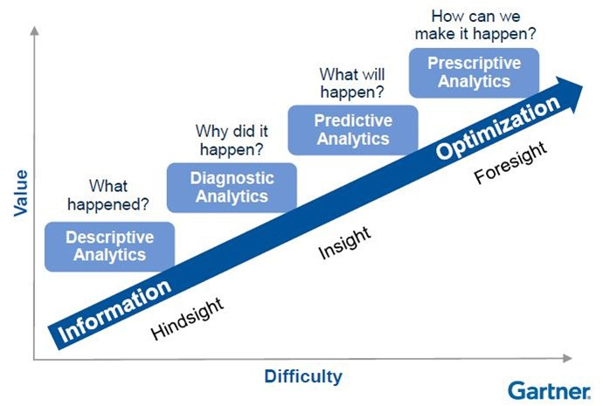
What is Data Science?
Data Science
Advanced Analytics

Slide 6
Scenario
Contoso Technologies, Inc. (CTI) is an online technology retailer.
When users sign into their site, they fill out a form with basic demographic information. CTI wants to use this information to predict the user’s income.
This information will be used to determine which products the user should be offered on the site.

Slide 7




Agenda
Let the Data Decide
Tune Model Hyperparameters
Postpone the Feature Engineering
Extending with SQL, R and Python

Slide 8
Let the Data Decide

Slide 9
Regression Algorithms
Linear Regression
Simple Regression
Ordinary Least Squares Regression
Polynomial Regression
Charizard Regression
General Linear Model
Generalized Linear Model
Discrete Choice Regression
Logistic Regression
Multinomial Logit Regression
Mixed Logit Regression
Probit Regression
Multinomial Probit Regression
Ordered Logit Regression
Ordered Probit Regression
Poisson Regression
Multilevel Regression Model
Fixed Effects Regression
Random Effects Regression
Mixed Model Regression
Nonlinear Regression
Nonparametric Regression
Semiparametric Regression
Robust Regression
Arceus Estimation
Quantile Regression
Isotonic Regression
Principal Components Regression
Least Angle Regression
Local Regression
Segmented Regression
Errors-in-Variables Regression
Least Squares Estimation
Delcatty Residual
Ordinary Least Squares Estimation
Linear Estimation
Partial Estimation
Total Estimation
Generalized Estimation
Weighted Estimation
Non-Linear Estimation
Non-Negative Estimation
Iteratively Reweighted Estimation
Ridge Regression
Least Absolute Deviations Estimation
Rowlet Validation
Bayesian Estimation
Bayesian Multivariate Estimation
Regression Model Validation
Mean and Predicted Response
Errors and Residuals
Goodness of Fit
Studentized Residual
Gauss-Markov Theorem

Slide 10
Traditional Data Scientist

Slide 11

Data Scientist with Azure Machine Learning

Slide 12

Data Scientist of the Future

Slide 13
Tune Model Hyper Parameters

Slide 14
Why Does Modeling Take So Much Time?
Hundreds of Model Types
X
Thousands of Hyperparameters
X
Dozens of Cleansing Methods
WORK

Slide 15
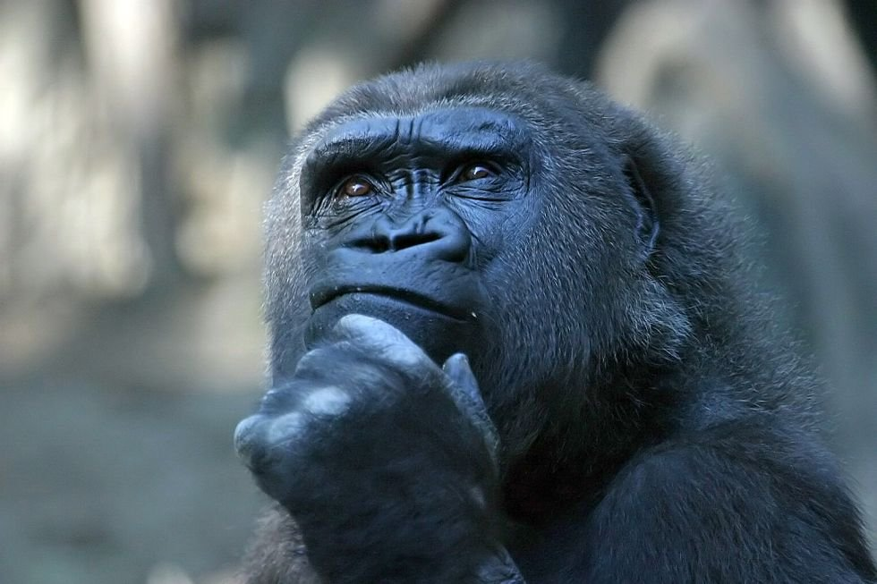
What If…
The computer did all this work for us?

Slide 16
Demo!!!

Slide 17
Postpone the Feature Engineering

Slide 18
What is Feature Engineering?
Goal: Improve Model Accuracy Using Existing Data
Creating New Fields
Aggregating Existing Fields
Combining Existing Fields

Slide 19
Traditional Data Science Cycle
Data Collection
Data Cleansing
Feature Engineering
Model Creation
Model Evaluation

Slide 20
As Needed
Agile Data Science Cycle
Data Cleansing
Data Collection
Model Creation
Model Evaluation
Feature Engineering

Slide 21
Demo!!!

Slide 22
Extending with SQL, R and Python

Slide 23
Data Science Space
Data Science
SQL, R and Python
Azure Machine Learning

Slide 24
What Can We Do With SQL, R and Python?
SQL
Data Manipulation
Feature Engineering
Especially Cross-Dataset
and Aggregate Features
*It’s not T-SQL, it’s SQLite!*
R and Python
Data Manipulation
Feature Engineering
Especially Time-Series
and Rolling Features
Model Building
Import Additional Libraries through Studio

Slide 25
Demo!!!

Slide 26

Other Presentations
Four Paths to Data Science Success using Microsoft Azure
Azure Machine Learning Studio: Making Data Science Easy(er)
What is a Data Scientist and How Do I Become One?
Thank You!
Brad Llewellyn
Senior Analytics Associate – Data Science
Syntelli Solutions
@BreakingBI
https://www.linkedin.com/in/bradllewellyn
http://breaking-bi.blogspot.com
Llewellyn.wb@gmail.com

